Slide 1
The History of SAMO
At the JRC and beyond …
Stefano Tarantola

Slide 2

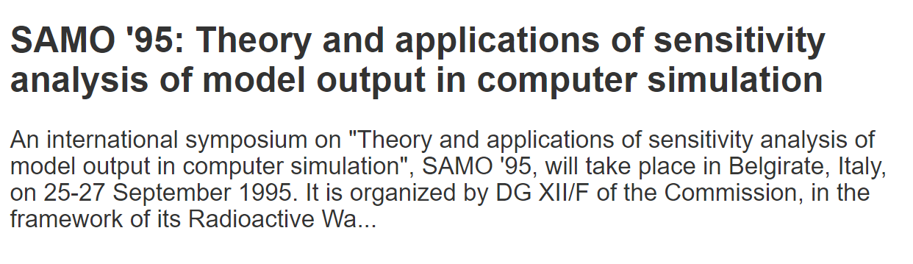
1995 – Belgirate (Italy)
Organised by Andrea Saltelli
who invited Professor Sobol’
to spend some time in Ispra

Slide 3
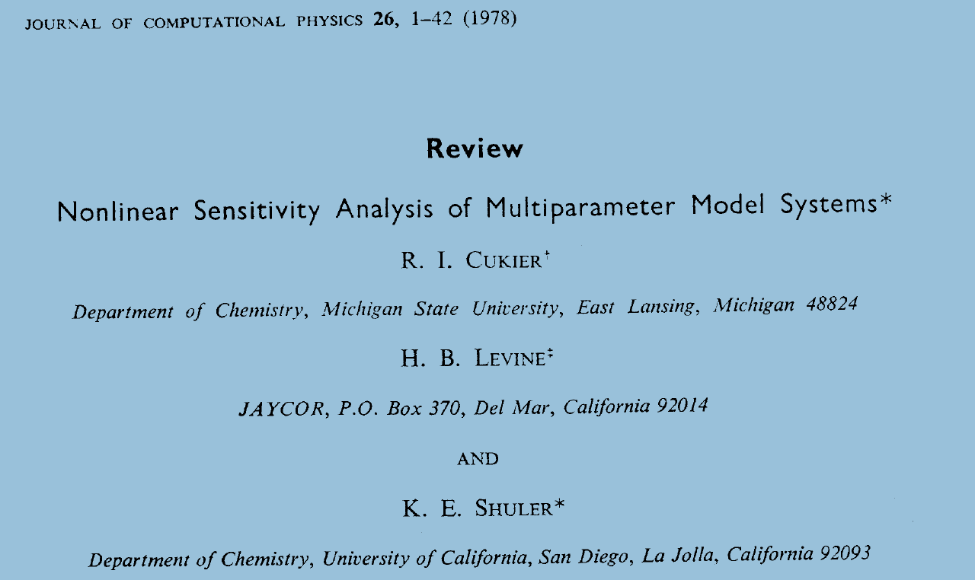
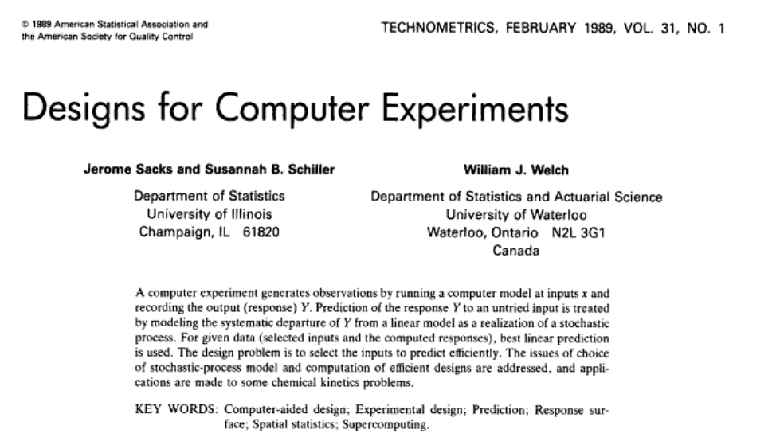
Let’s go back to the Seventies - Eighties
FAST by Cukier et al.
Sachs and Welch – Response surface methods

Slide 4
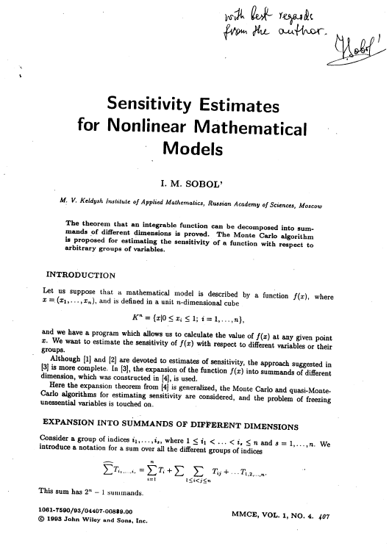
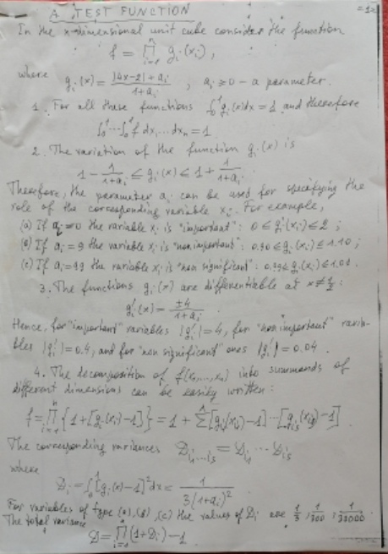
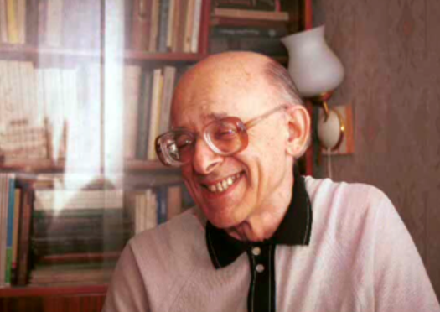
The work of Sobol’ (1990 – 1993)

Slide 5
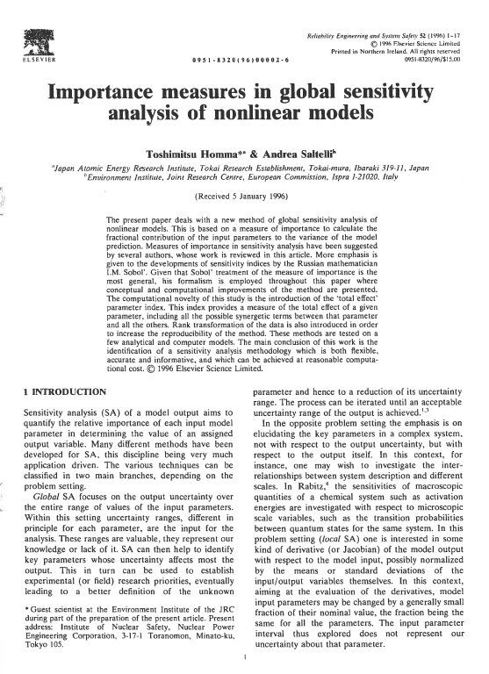

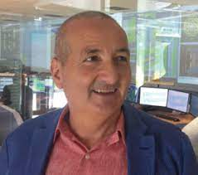
RESS 1996 – Total Sensitivity Indices

Slide 6
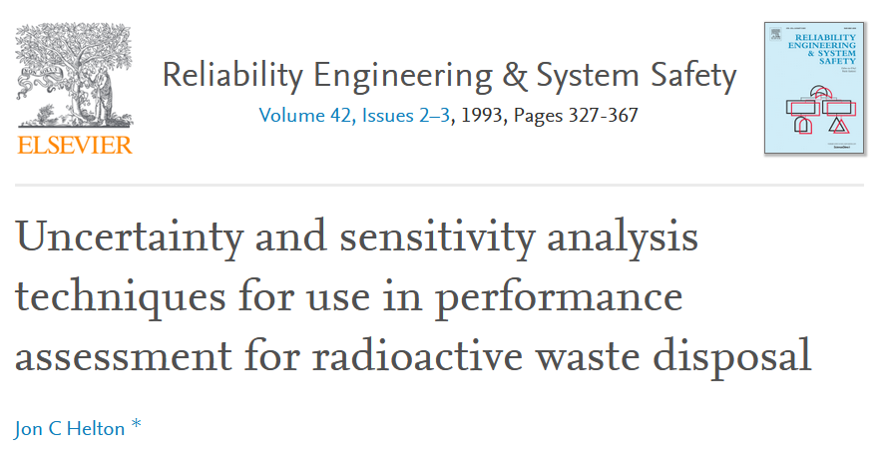
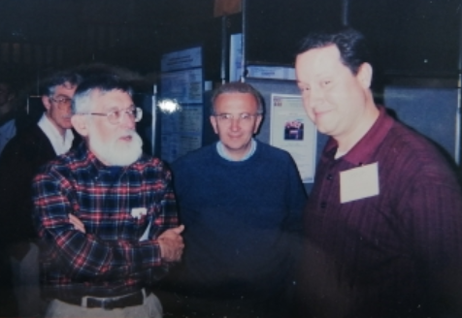
1996 – I start my experience at the JRC

Slide 7
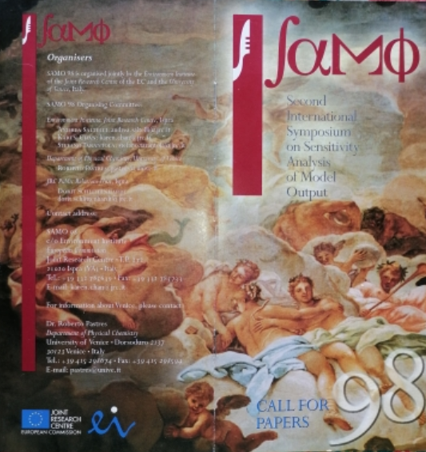

1998 Venice
Second International Conference in Ca’ Foscari (120 participants)

Slide 8
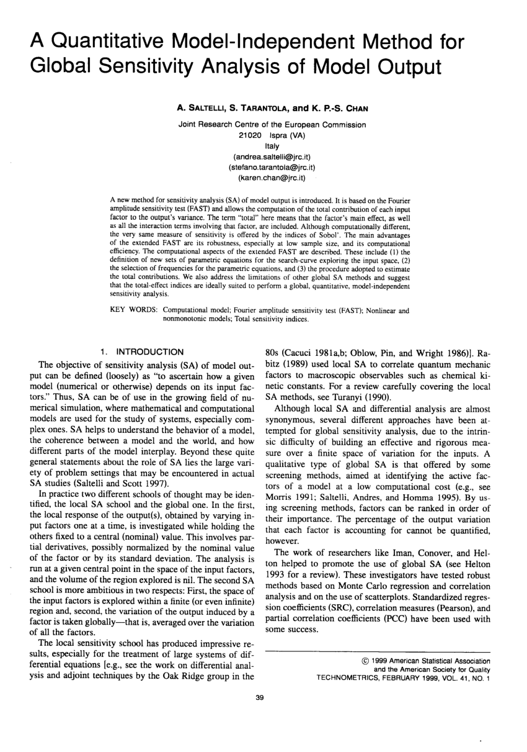
Technometrics 1999 – The Extended FAST
First Order and Total Indices
Using Fourier Analysis

Slide 9
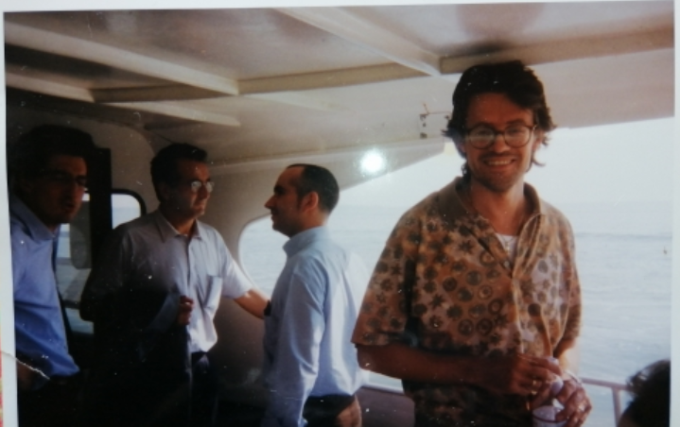

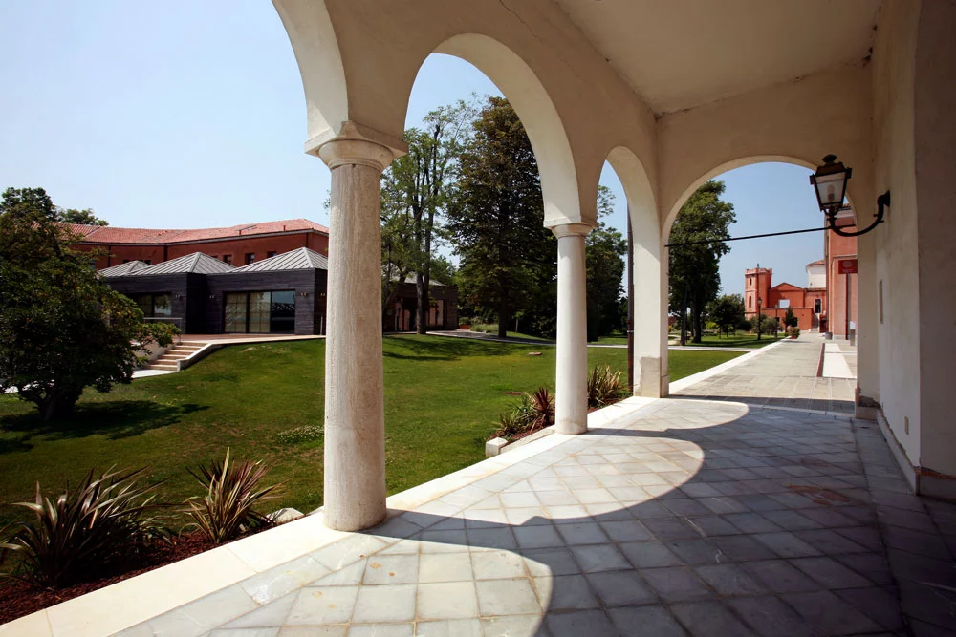
1999 The First Summer School (Venice)
San Servolo Island
Pic on the boat to San Servolo
Earlier an asylum for the insane, the island is now home to a museum, the Venice International University, and a neuroscience school of advanced studies.

Slide 10
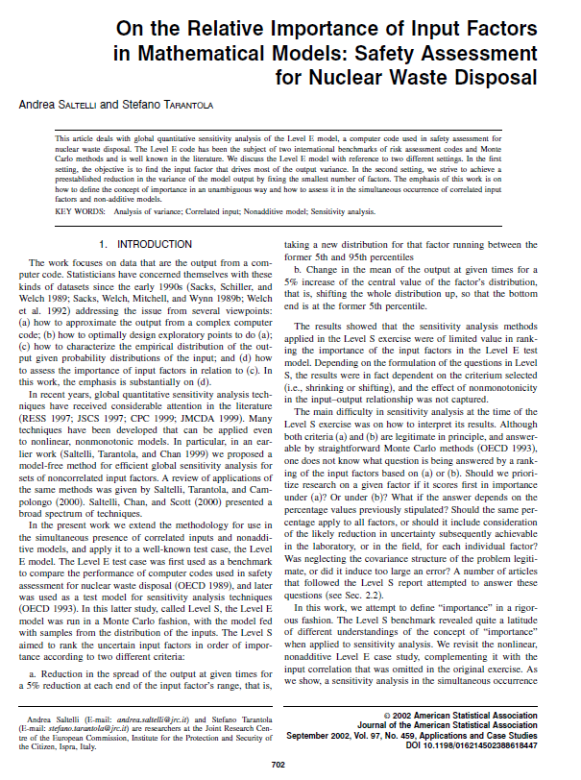
JASA 2002 – The Settings
Setting 1: Factor Prioritisation
Setting 2: Factor Fixing
Setting 3: Max Variance Reduction

Slide 11
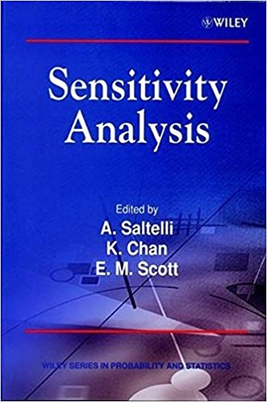


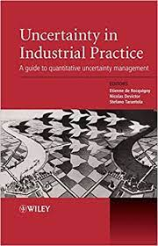
2000 – 2004 – 2008 The Wiley Books

Slide 12
Activity 2000 - Today
and new applications
Fluorishing of new methods
Derivative-based
Moment independent measures
Polynomial chaos expansions
Random Balance Designs
Engineering
Hydrology
Environment
Chemistry
Biology

Slide 13
Activity 2000 - Today
Challenges
Correlated input
Time dependent input
Spatially dependent input
SA for scenarios analyses
Sensitivity Auditing

Slide 14


Andrea Saltelli’s work
Sensitivity Auditing, science for policy
Impact assessment guidelines
Crisis of Science
Model Transparency
Responsible modelling
Sociology of quantification
Notes:
Sensitivity auditing where there is a major disagreement among
stakeholders about the nature of the problem, …
then sensitivity auditing is more suitable but
sensitivity analysis is still advisable as one of the
steps of sensitivity auditing.
Saud takes into account all forms of potential uncertainty and aims to anticipate criticism by third parties.
We should avoid quantification at all costs and Saud is a powerful tool for this.

Slide 15
Activity 2000 - Today
Schools of thought
Main Software
UQ Lab platform for Uncertainty Quantification (Bruno Sudret – ETH Zurich)
Mascot-Num (France)
U. of Texas @ Austin
MUCM (Managing Uncertainty in Complex Models – U. Sheffield)
UQLib (Matlab by UQLab)
R packages for Sensitivity Analysis
SimLab (now SIML@B by JRC)
SimDec (hybrid SA-UA)
SmartUQ (US-based software house)

Slide 16
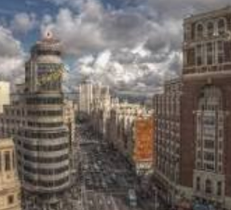
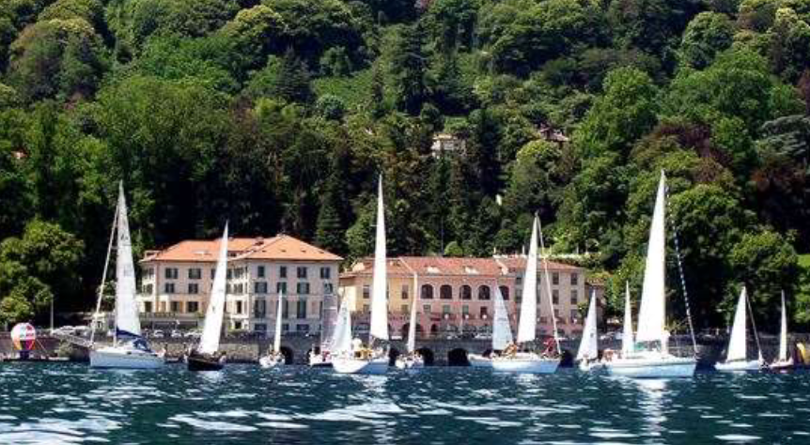
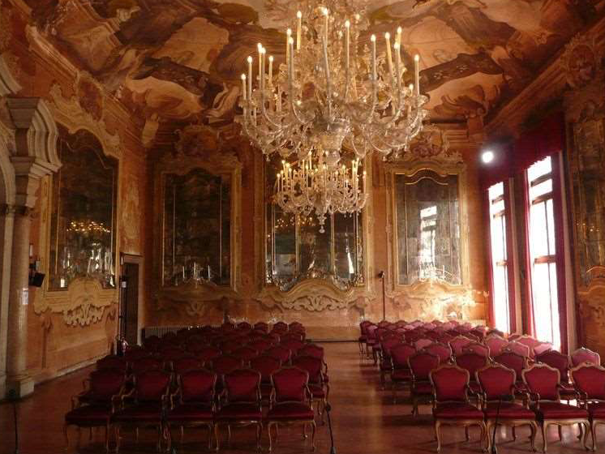



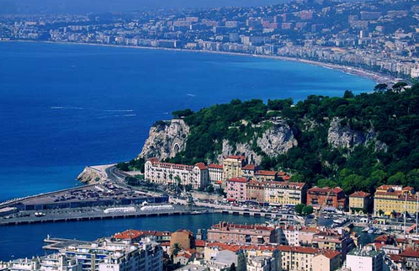
SAMO Conferences (1995-2022)
1995 – Belgirate (I)
1998 – Venice (I)
2001 – Madrid (E)
2004 – Santa Fe (NM)
2007 – Budapest (H)
2010 – Milan (I)
2013 – Nice (F)

Slide 17
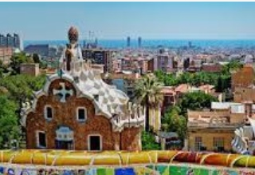
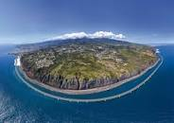
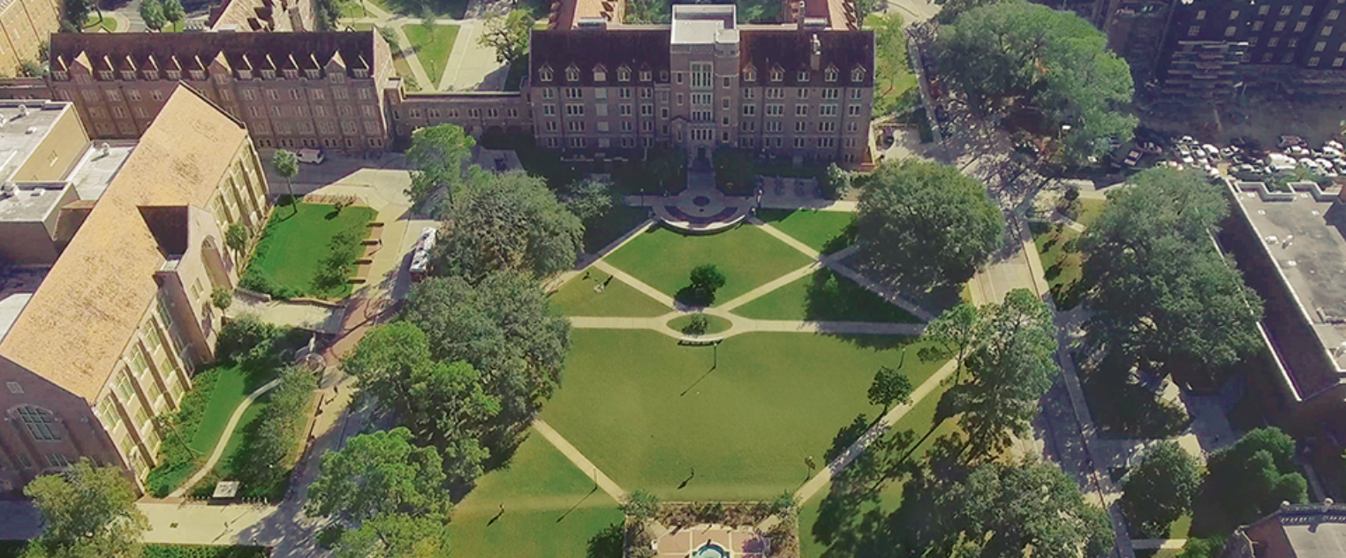
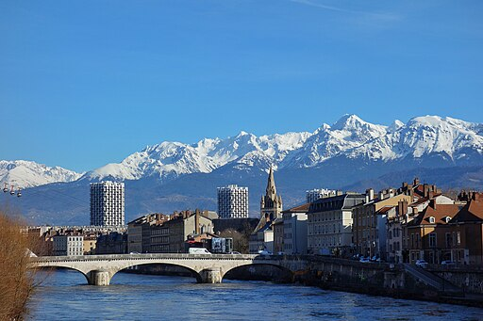
SAMO Conferences (2001-Today)
2016 – Reunion (F)
2019 – Barcelona (E)
2022 – Tallahassee (FL)
2025 – Grenoble (F)

Slide 18
SAMO Grenoble (23-25 April, 2025)
Scientific Committee
Clementine Prieur (Univ-Grenoble) Local organiser
Bertrand Iooss (Electricité de France) Local organiser
Sergei Kucherenko (Imperial College)
Stefano Tarantola (JRC ISPRA)
Andrea Saltelli (UPF, U. Bergen)
Giray Okten (Florida State University)
Qiongli Wu (WIPM)
Emanuele Borgonovo (Bocconi University)
Bruno Sudret (ETH Zurich)
Thierry Mara (University of Reunion)
Razavi, Saman (NHRC)
Samuele Lo Piano (Reading University)
Anthony Jakeman (Australian State University) Silvana.pesenti (University of Toronto)
Rossana Rosati (JRC-ISPRA)
Juliane Mai (University of Waterloo)
Call for Papers
will soon be published

Slide 19
SAMO: 29 Years of sensitivity analysis
Not a discipline or silo
but a self-aggregating community
No decisional structure, no journal
just a free quest for best practices
No methodological red-lines,
But an open approach to finding the best solutions
Text borrowed by one of Andrea’s slides

Slide 20








Keep in touch
ec.europa.eu/
europeancommission
europa.eu/
@EuropeanCommission
@EU_Commission
EUTube
@EuropeanCommission
EU Spotify
European Commission
Notes:
Delete/update as appropriate

Slide 21

Thank you
© European Union 2020
Unless otherwise noted the reuse of this presentation is authorised under the CC BY 4.0 license. For any use or reproduction of elements that are not owned by the EU, permission may need to be sought directly from the respective right holders.
Slide xx: element concerned, source: e.g. Fotolia.com; Slide xx: element concerned, source: e.g. iStock.com
Notes:
Update/add/delete parts of the copy right notice where appropriate.
More information: https://myintracomm.ec.europa.eu/corp/intellectual-property/Documents/2019_Reuse-guidelines%28CC-BY%29.pdf

